Slide 1
HANSEN GLOBAL EXPLORING THE GLOBAL FOREST DATA IN Google Earth Engine Mary Amponsah mamponsah@ug.edu.gh Center for Remote Sensing and Geographic Information Services CERSGIS
Accra, Ghana
September, 2021

Slide 2
OVERVIEW
Global Forest Change is the results from time-series analysis of Landsat images in characterizing global forest extent and change from 2000 through 2020
The Hansen et al. (2013) Global Forest Change dataset in Earth Engine represents forest change, at 30 meters resolution, globally, between 2000 and 2020
In this section, we will explore the Hansen Global Forest Change dataset in Google Earth Engine for forest cover and loss estimation

Slide 3
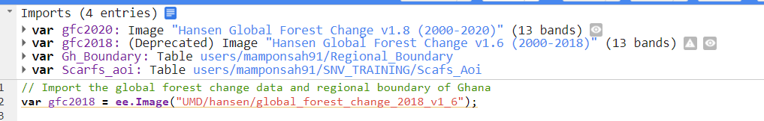
Importing image and features
Import the Hansen Global Forest Change version, yearly based, and other features ( i.e. Ghana Regional Boundary and the SCAFS Project area of interest)

Slide 4
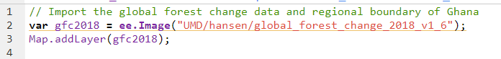
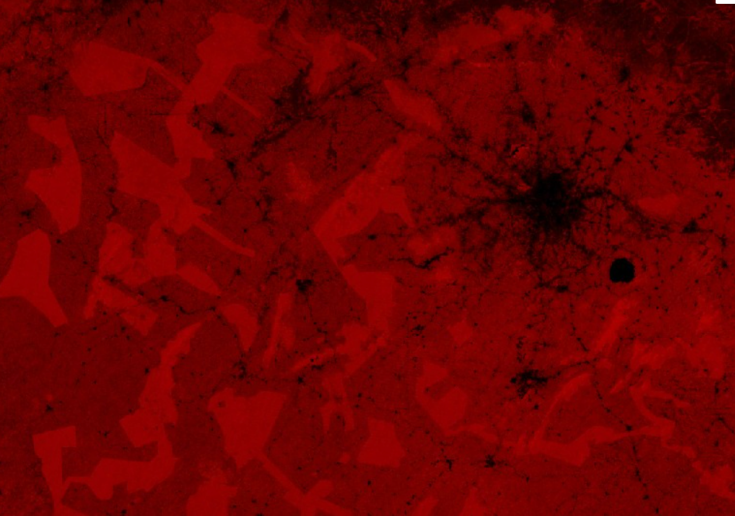
Adding and Visualizing GFC Products
Import and visualize global forest change 2018
The image looks red because:
The first 3 bands (i.e. treecover2000, forest loss, and forest gain) are displayed as red, green, and blue, respectively
Stretched according to the data type of each band.
Notes:
To gain understanding of the bands in the Global Forest Change data, refer to this link : https://storage.googleapis.com/earthenginepartners-hansen/GFC-2020-v1.8/download.html

Slide 5

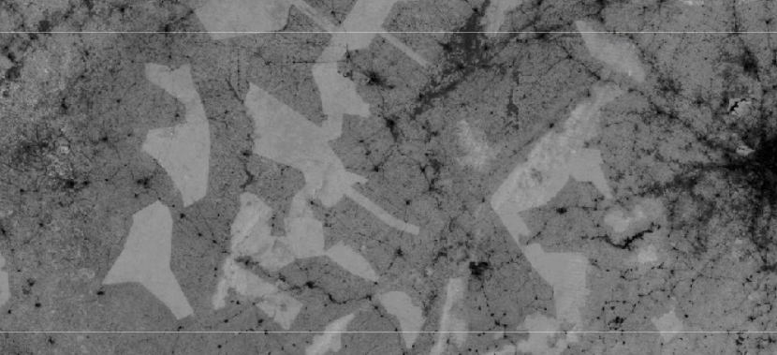
Visualizing GFC Products in Greyscale
Display the forest cover in 2000 as a grayscale image, using the treecover2000 band, specified in the second argument to the Map.addLayer() method:

Slide 6
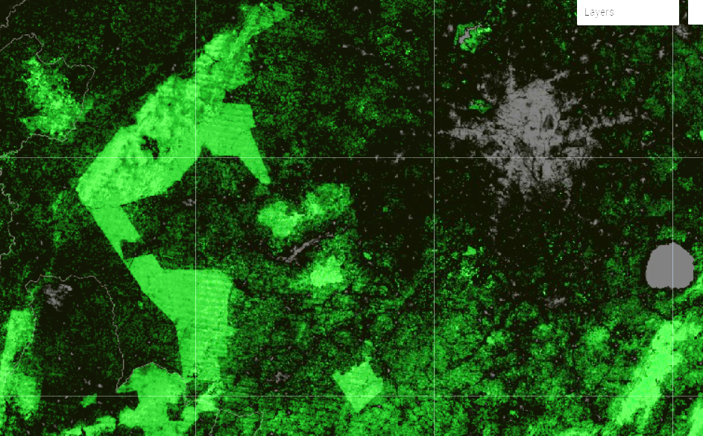
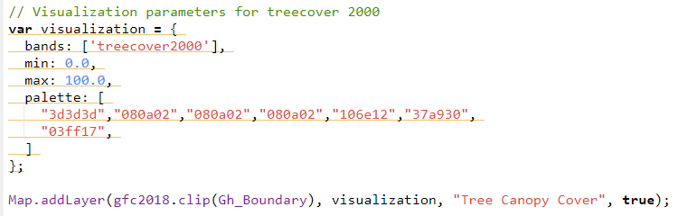
Visualizing GFC Products in other colours
Display forest cover in 2000 with a range of colors specified in the visualization parameters, using the treecover2000 band.
Clip to an area of interest in Ghana

Slide 7

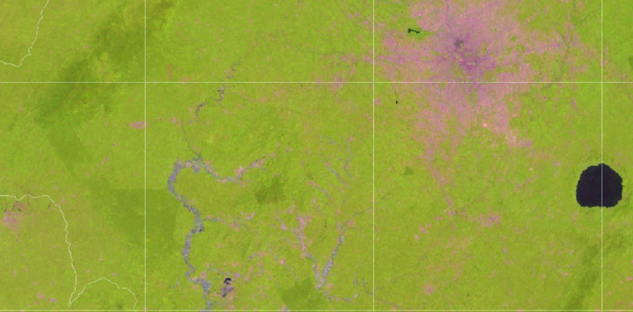
Visualizing as False Colour Composite
Display the forest cover in 2018 as FCC composite image, using bands 5, 4 and 3.
Clip to an area of interest in Ghana

Slide 8
Visualizing GFC Products
Visualizing the forest extent in 2000 as Green, forest loss as Red, and forest gain as Blue
To enhance the image further, apply histogram stretching by setting the max and min values.
The result is an image, where, forest is green, forest loss is red/orange and forest gain appears blue; magenta for areas where there is both forest gain and loss.
Notes:
The forest loss and gain bands are binary, so they are barely visible.

Slide 9
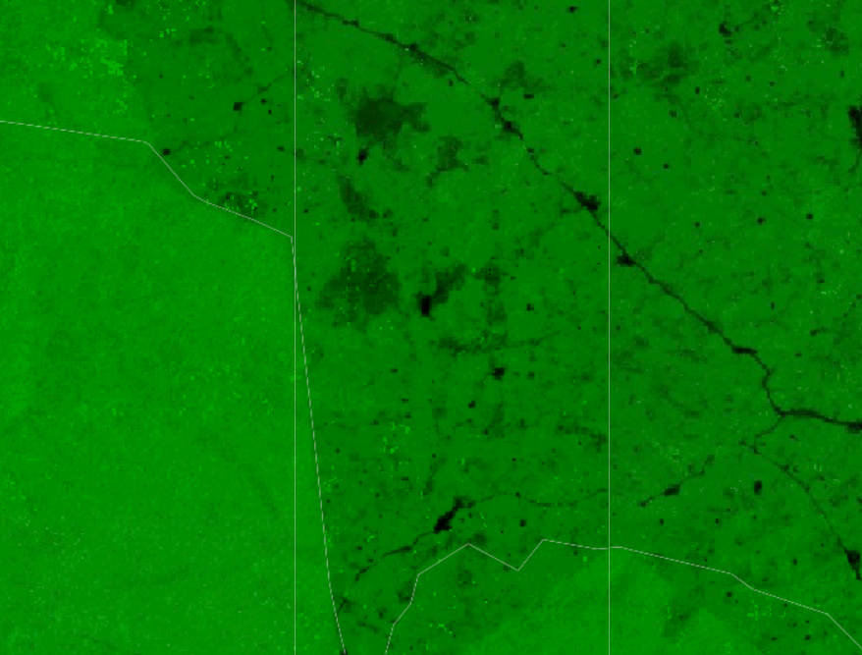

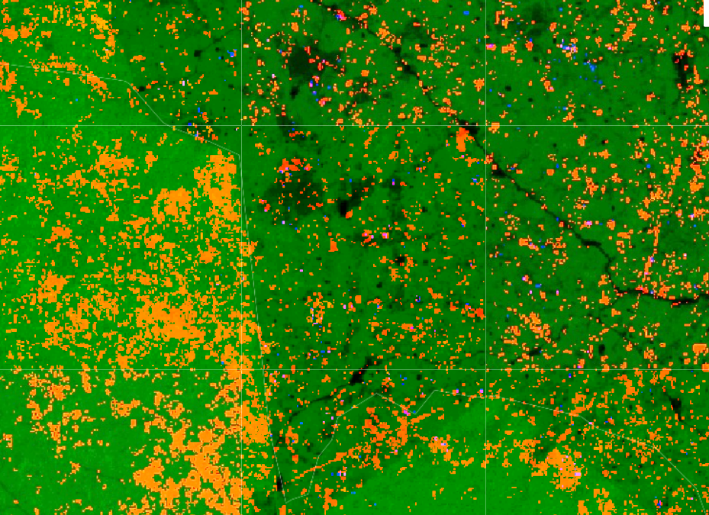
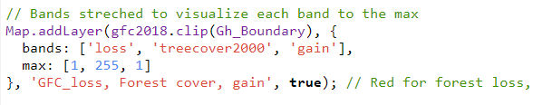
Notes:
The forest loss and gain bands are binary, so they are barely visible in the first picture

Slide 10
MASKING
All of the images shown so far have black areas. These areas, such as water bodies have data values of zero.
Mask these areas to make them areas transparent/fade
Instead of specifying the bands parameter in the Map.addLayer () method, create new images using select() and
Use the palette parameter of Map.addLayer() for single band images

Slide 11
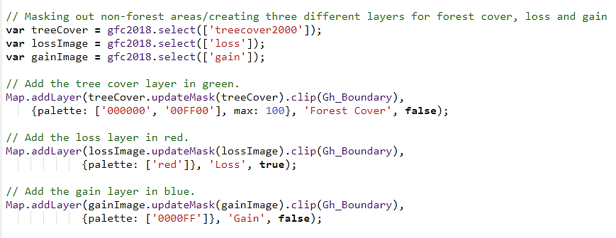
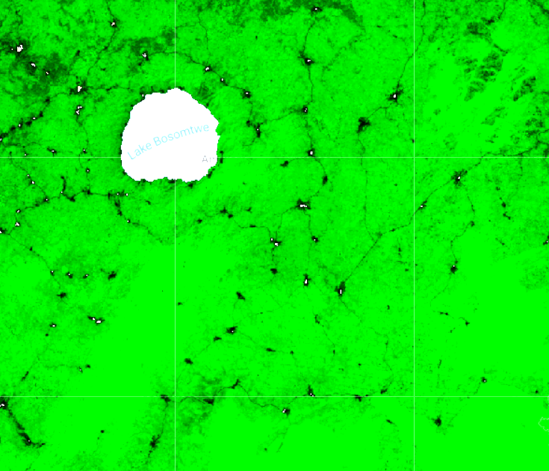
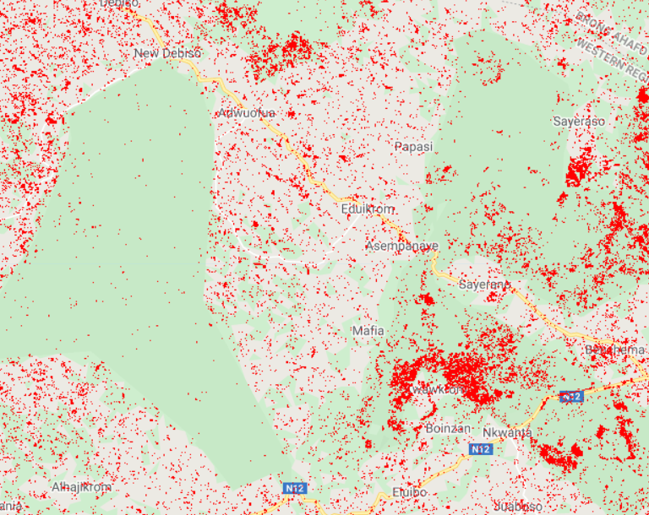
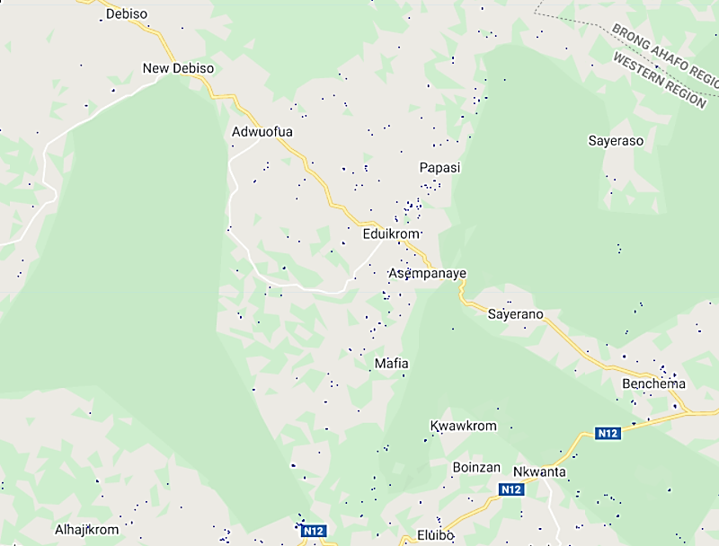
MASKING AND VISUALIZING GFC BANDS
Tree cover
Forest loss
Forest Gain
Notes:
The forest loss and gain bands are binary, so they are barely visible.

Slide 12
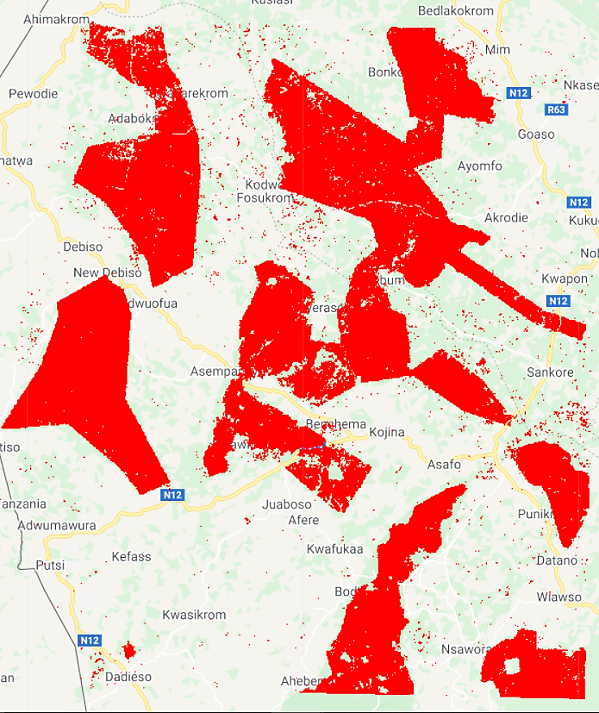
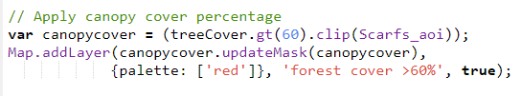
Canopy Percentage Cover
Apply a canopy cover greater than 60% to the SCAFS Project area of interest and visualize this.

Slide 13
Calculating Yearly Forest Area Loss
The yearly total forest area loss will be calculated using the grouped reduceRegion () Method.
To group output of reduceRegion(), specify a grouping band that defines groups by integer pixel values.
Add the lossYear band to the original image. Each pixel in the lossYear band contain values from 0 to 18 indicating the year in which the loss occurred
Use a grouped reducer, specifying the band index of the grouping band (1) so the pixel areas will be summed and grouped according to the value in the lossYear band.
Clip to SCAFS Project area of interest.
Print the yearly forest loss area

Slide 14
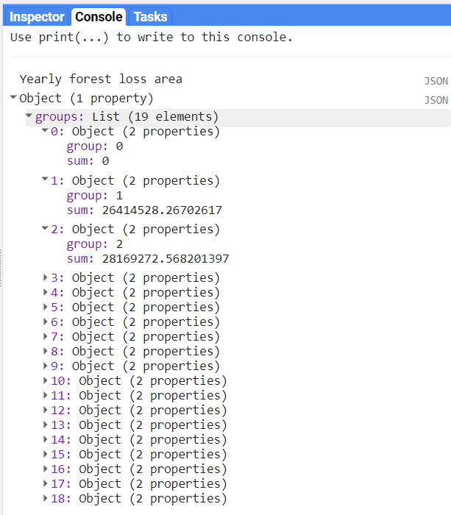
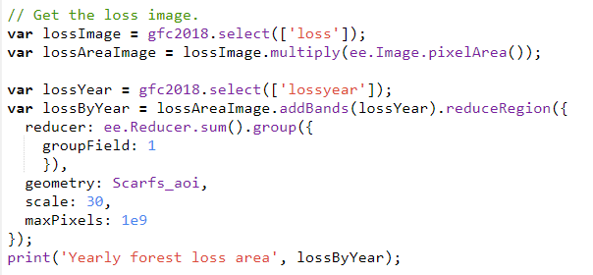
Calculating Yearly Forest Area Loss

Slide 15
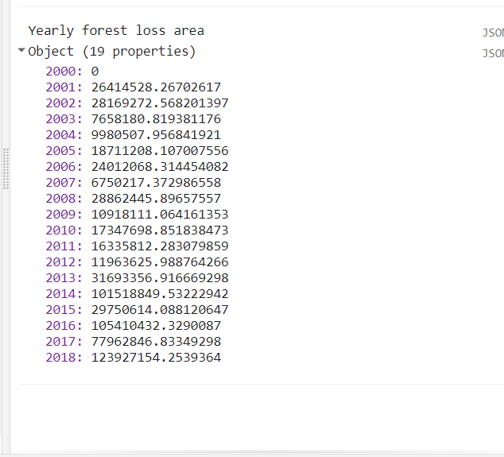
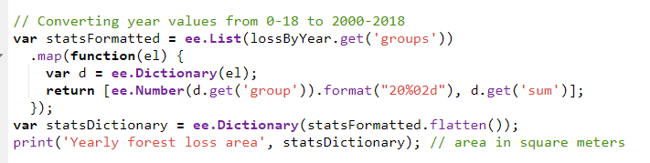
Convert Year Values from 0-18 to 2000-2018
Format the output to make the result a dictionary, with year as the key and loss area as the value.
Notice that using the format() method converts the year values from 0-18 to 2000-2018.

Slide 16
Link to GEE Script
https://code.earthengine.google.com/19f59c93151905394be7a99e6adbf96b

Slide 17
Hands–on Exercises
Add and visualize the treecover, forest loss and forest gain bands in the Western North Region of Ghana for 2020.
Apply a canopy cover of 70% on the Region of Interest.
Compute the yearly forest loss area for Bia West.

Slide 18




Thank You
Accra, Ghana
September, 2021
Notes:
It's free for non-commercial use!

